Slide 1



Software engineering (Undergraduate)
Chapter 2
software development process model
Course Name
software engineering
CSC 3114
(Undergraduate)
M. Mahmudul hasan
Assistant Professor, CS, AIUB
http://www.dit.hua.gr/~m.hasan

Slide 2
Software process
Slide-
A structured set of activities required to develop a software system
A software process model is an abstract representation of a process.
It presents a description of a process from some particular perspective
MMH

Slide 3
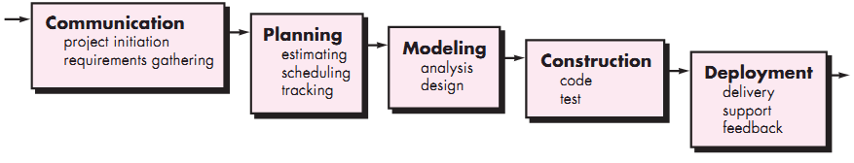
Waterfall model
Slide-
The waterfall or linear sequential model
Problems of Waterfall Model
Inflexible partitioning of the project into distinct stages where next phase starts only after completion of the previous phase
This makes it difficult to respond to changing customer requirements (no backtracking)
Therefore, this model is only appropriate when the requirements are well-understood
MMH

Slide 4
Aspect | ✅ Advantages | ❌ Disadvantages
Simplicity | Easy to understand & implement. | Too rigid and inflexible for real-world applications.
Best for Small Projects | Works well for small & defined projects. | Not suitable for large or complex systems.
Management | Easy to manage with clear phases. | Changes are difficult to implement.
Structured Approach | Each phase is well-documented and follows a logical order. | No overlapping of phases, which slows down development.
Requirement Stability | End goal is determined early, avoiding scope creep. | Requires complete & accurate requirements upfront, which is often unrealistic.
Testing | Testing is done after development, reducing confusion. | Testing occurs late, making error detection costly.
Risk Management | Basic framework for other models | Risks are not assessed, leading to high uncertainty.
Time to Market | Predictable timeline due to its structured nature. | Working software is not available for a long time, delaying user feedback.

Slide 5
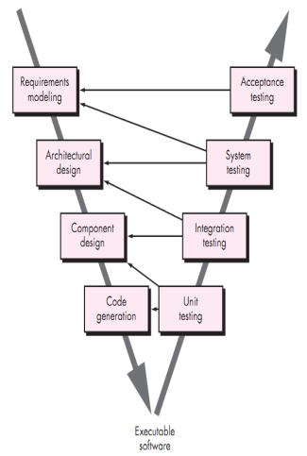
V - model
Slide-
The V-model is a SDLC model where execution
of processes happens in a sequential manner in
V-shape. It is also known as Verification and
Validation model.
V-Model is an extension of the waterfall model and
is based on association of a testing phase for each
corresponding development stage. This means
that for every single phase in the development
cycle there is a directly associated testing phase.
This is a highly disciplined model and next phase
starts only after completion of the previous phase.
MMH

Slide 6
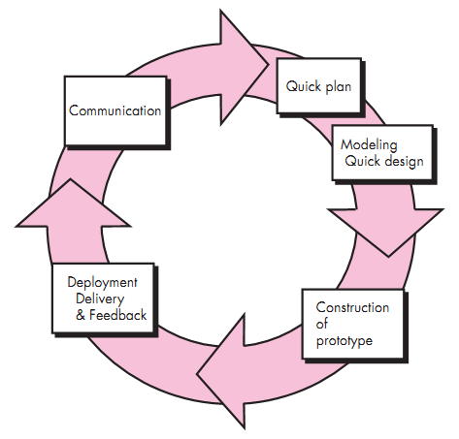
Prototyping model
Slide-
Requirements are not clear and prototype serves
as a mechanism for identifying software requirements
Iteration occurs as the prototype is tuned
to satisfy the needs of the customer
System requirements ALWAYS evolve in the course of a project, so process iteration is useful where earlier stages are reworked is always part of the process for large systems
MMH

Slide 7
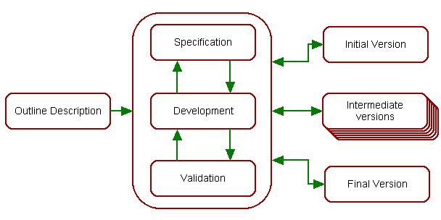
Evolutionary development
Slide-
Exploratory development: Objective is to work with customers and to evolve a final system from an initial outline specification. Should start with well-understood requirements
Throw-away prototyping: Objective is to understand the system requirements. Should
start with poorly understood requirements
MMH

Slide 8
Incremental development
Slide-
Rather than deliver the system as a single delivery, the development and delivery is broken down into increments with each increment delivering part of the required functionality (SPIRAL).
The requirements are relatively certain but there are many complexities that leads to frequent changes.
User requirements are prioritised and the highest priority requirements are included in early increments
Once the development of an increment is started, the requirements are frozen though requirements for later increments can continue to evolve
Analysis
Design
Code
Test
Delivery
increment #1
Analysis
Design
Code
Test
Delivery
increment #2
Analysis
Design
Code
Test
Delivery #3
Calendar time
MMH

Slide 9
Incremental development
Slide-
Advantages of Incremental Development
Customer value can be delivered with each increment so system functionality is available earlier
Deliver the core product first
Early increments act as a prototype to help elicit requirements for later increments
Lower risk of overall project failure
The highest priority system services tend to receive the most testing
MMH

Slide 10
Rapid Application Development (RAD)
Slide-
It is a type of incremental model. The developments are time boxed, delivered and then assembled into a working prototype
In RAD model the components or functions are developed in parallel as if they were mini projects (frozen requirements in each increments)
This can quickly give the customer something to see and use and to provide feedback
Delivers a fully functional system in 90 days, give or take 30 days
Phases of RAD are:
  Requirements Planning
  User Design (user interact with the system analysts)
  Construction (program and application development)
  Cutover (testing, changeover to new system, user training)
MMH

Slide 11
Component based development model
Slide-
Identify
component
Suitable for re-usable object oriented classes
Apply characteristics of spiral development
Construct
nth inter
system
Lookup
components
in library
Put new
components
in library
Exract
components
if available
Build
components
if unavailable
MMH

Slide 12
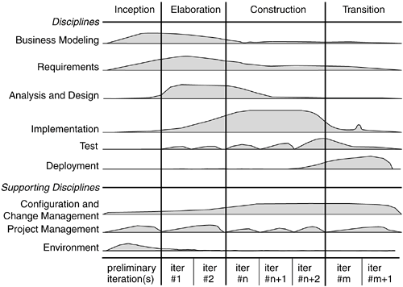
Rational Unified Process (RUP)
Slide-
MMH

Slide 13
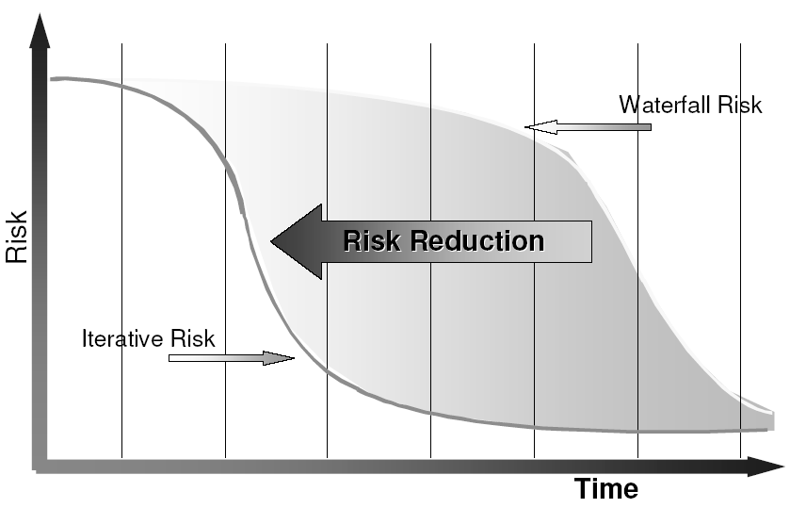
Risk profile
Slide-
MMH

Slide 14
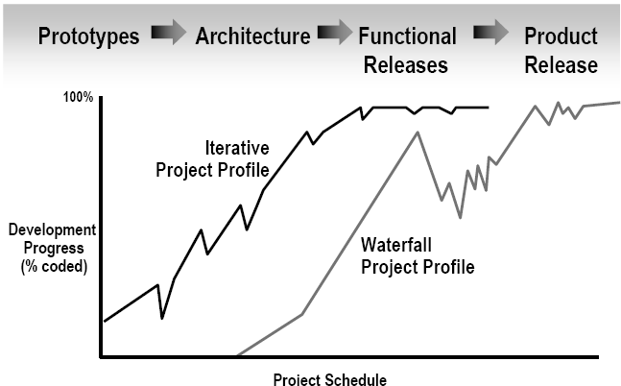
Reduce Scrap/Rework: Use an Iterative Process
Slide-
Iterative Development
Products are visible at an early stages of development
Low probability of rework in case of defects in the deliverable product
MMH

Slide 15
references
Slide - 14
R.S. Pressman & Associates, Inc. (2010). Software Engineering: A Practitioner’s Approach.
Kelly, J. C., Sherif, J. S., & Hops, J. (1992). An analysis of defect densities found during software inspections. Journal of Systems and Software, 17(2), 111-117.
Bhandari, I., Halliday, M. J., Chaar, J., Chillarege, R., Jones, K., Atkinson, J. S., & Yonezawa, M. (1994).
In-process improvement through defect data interpretation. IBM Systems Journal, 33(1), 182-214.

